Slide 1






Approach
Notes:
“The Gym at Sky have asked for a core KPI pack and self-serve data on performance to help them
increase membership and reduce queue times at busy periods.”
Presentation structure:
Discuss the initial approach with client – determine what data is collected/available + what is most important to the client/dashboard
Run through potential KPIs for membership and queue times and any issues – example of dashboards
Explain how client will be able to self-serve using these dashboard once they’ve been set up
First: Discuss with client how they currently track membership levels and queue times – if they don’t then how might we do so using data available
Which of these measures are most important to them – determine which of them require greatest visibility on the dashboard
Second: Are the any other relevant measures (specific to membership/queue times) that aren’t being tracked that might provide value as part of a dashboard?
Third: Collate all measures above
Do we currently collect data that is aligned to these measures, e.g. :
Count of members: need tables stating join date and leaving date
Queue times for a machine: need tables specifying machine id, when a member started waiting, when they started using the machine (difference between two is queue time)
Fourth: based on points above come up with KPIs for membership and queue times
Where we currently collect data that is well aligned with what we’re trying to measure, e.g. count of members, this should be used
If we don’t currently collect data then we’ll need to come up with other indicators that can be used as proxies for that measurement, e.g. queue times for a machine – measure how busy a certain area of the gym is as opposed to exact waiting times for a specific piece of equipment (as unlikely for that information to be captured)
Where this is the case explain this to client – what is the data showing and how is that different to what we’re trying to measure? How should/shouldn’t they use this measure to produce meaningful insights
Fifth: Where feasible, suggest additional data collection methods which may aid in measuring membership of queue times, e.g. capture additional demog. info at signup, customer sat. surveys, NPS machines, new tech., etc. These could be run ad hoc to determine whether or not proxies are good substitutes by linking that to existing data.
E.g. do survey scores for waiting time improve or get worse when the gym is busier? – how strong is that correlation?

Slide 2
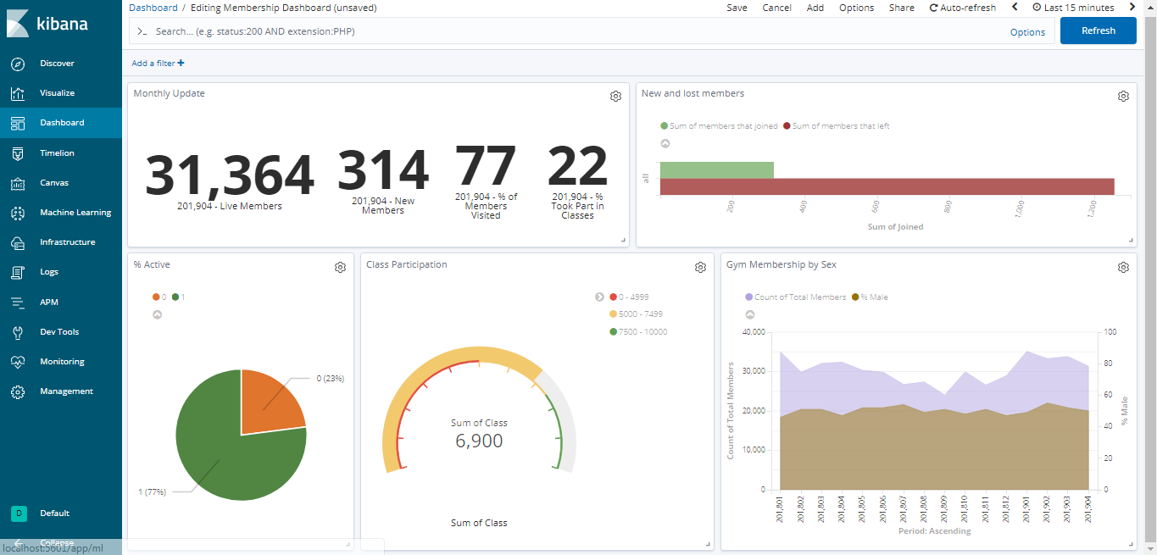
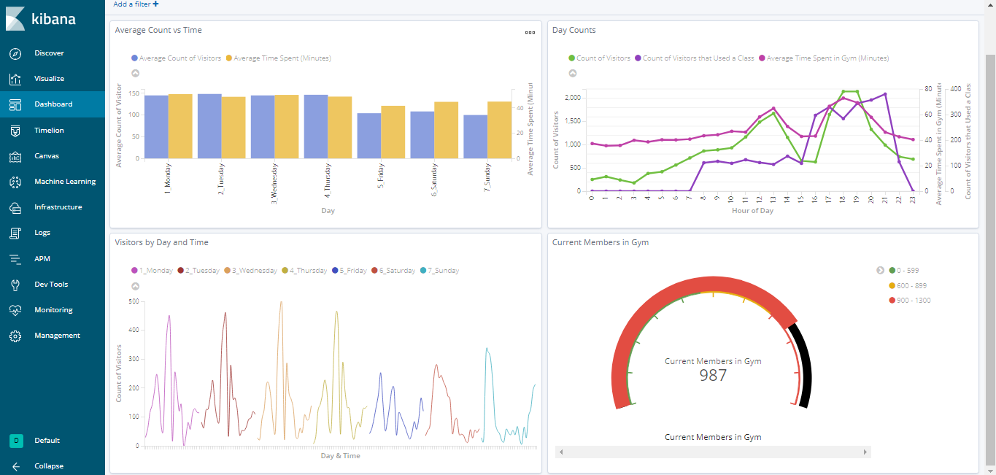
KPIs
Membership
Count of members
% Visited last 30 days
% Using classes
Churn rate
New Members
Queue Times
Count by day/hour
Average length of visit
Members currently in gym
Class use by day/hour
Class waiting lists
Notes:
Slide 2:
KPIs - Decide on KPIs - based on these show a high level sample dashboard for the latest period
Example KPIs for membership and queue times, based on discussion with client.
Membership:
Count of total gym members split by demogs. E.g. age, sex, etc. (can be run by any demog we capture from members) – are there any demog. profiles that underperform that we could target?
% of total members visited in last 30 days, i.e. that are active – can we do anything to target non-active members to encourage them to engage – reduce risk they leave
Engagement is key – greet members on way in (when appropriate), ask how their session was on way out – follow up with tips/comments based on exercises they took part in that session – ‘How was your workout today?’
% using classes – another measure of engagement – is this figure lower than it should be due to lack of variety/times for classes. Are there certain demogs that under index on class use?
Is there a target for % of members that use classes? Do we want to promote using classes more/less to members?
Churn rate – % of members that are cancelling their subscription. Is this increasing/decreasing? Why? – which demogs are leaving, how can we stop them leaving – Consider asking consumer sat. surveys to get feedback/improvement ideas
New members signed up in the latest period – what does this trend look like over time?
Queue Times:
Assuming we can’t measure queue times for specific machines or gym areas as that is difficult to capture. Therefore we need some other measurements, that we can capture, to act as proxies for this metric.
Count of visitors by day of the week and time of day (higher visitors indicates potentially greater queue length) – are there any days of the week or hours in the day that are busier than others i.e. busier therefore longer queues? How can we encourage people to come at off peak times? – class discounts, membership discounts for off peak times
Average time spent in gym by day of the week and by hour – does this correlate with count of visitors in the gym?
Live count of members currently in gym vs average – if higher than average can we shift more staff to gym area to engage with clients – can we educate them with exercises to do whilst they wait? Can we encourage/teach them to use other machines/techniques that target the same/similar muscle groups that aren’t being used to reduce queue times?
% of visitors that used a class by day and hour – is there a time where classes are more popular? Can we encourage greater class take up in other time periods? A greater proportion of members in classes reduces queues on gym floor
Waiting list size for classes – are there more members wanting to take part in classes but not able to do so due to capacity? Does this affect particular days/hours/demogs?
Top Level Dashboards
These show the key figures/stats for memberships and queue times for the latest period – can be set up for monthly/weekly/daily (example is monthly). Again, up to client to determine what is displayed here – most beneficial stats to be prioritised at the top.
If they spot any oddities/trends that need investigating then they can drill down further (next slide) – i.e. self-serve element.

Slide 3
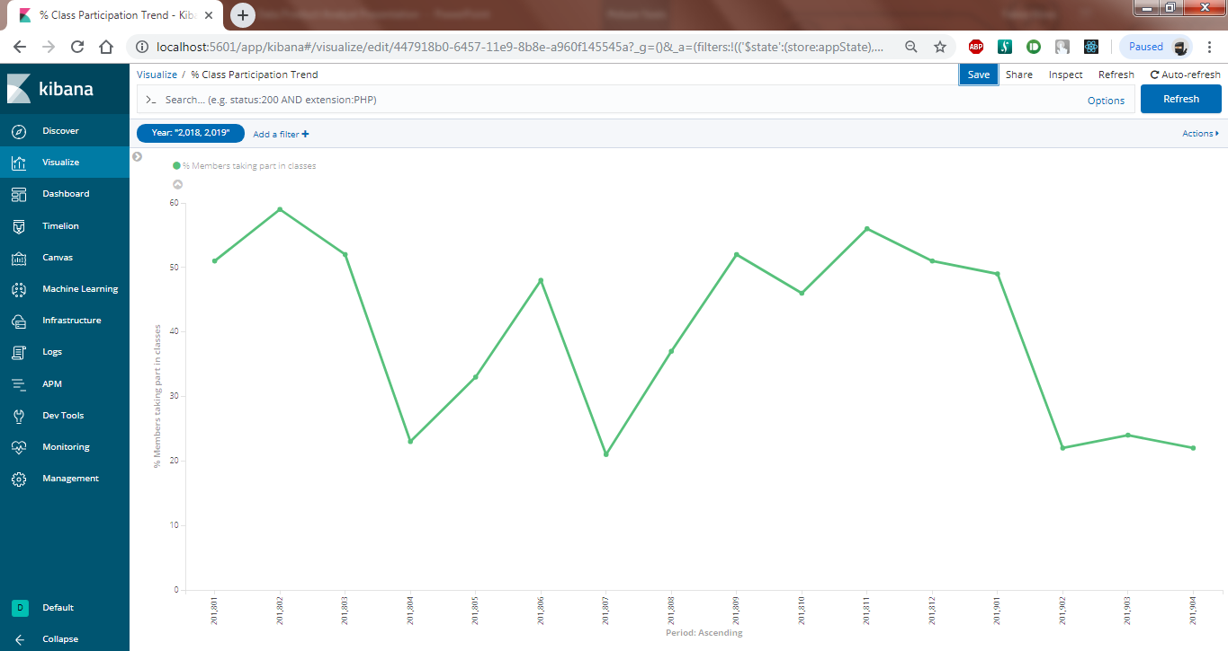
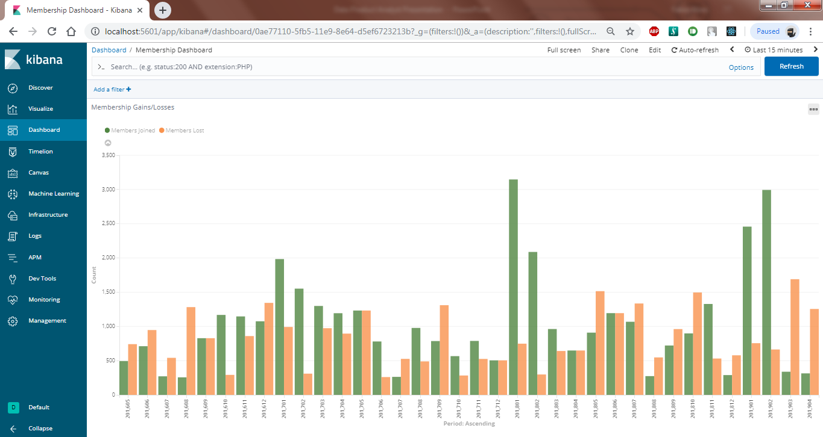
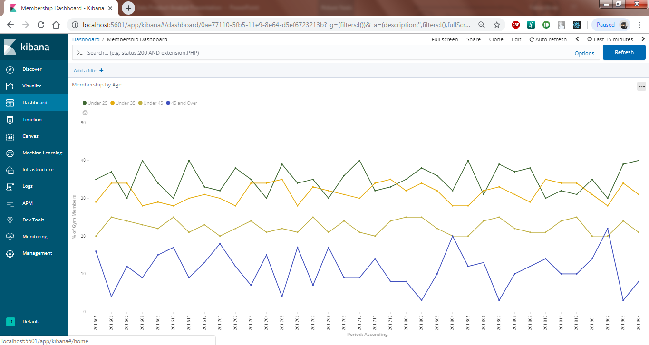
Self-Serve
Notes:
Slide 3: Examples of drilling down
Start of with initial top-level dashboard there are period specific KPIs relating to active users, class participation, new and lost members, total members split by sex over time. Will drill down into a few examples.
First: Number of members using classes in the ‘amber’ zone – how does this compare to historic figures? If you look at % since 2018 there was also a dip last year – so maybe not a cause for concern. Potential action to try and find out why members tend to reduce class participation in April? Could then drill down further, e.g. demogs., length of membership, etc.
Do people have less time due to Easter holidays? Do they spend less in the gym overall in same period?
Second: Number of members lost looks high relative to new members. Again, looking at historic trends its not unusual for new member count to drop at this time of the year. However, number of members lost is significantly higher than 201804 and 201704. Can do further analysis as above. Also worth client considering if they’ve started doing anything differently this year that isn’t captured in our data set which could be driving that change in behaviour.
After high influx of members in Jan do people lose interest after Q1 – if this is the case, why? – how can we prevent this? Potential engagement issues referred to in slide 2 – do we need to focus more on customer service at this point to try and keep them engaged/motivated?
Third: Active members at 77%. Client may want to look at demog. Composition of those members over time – is it changing? How does this differ from demog. Profile of Sky employees – are there groups that under/over index?
At any point they can always go back to the original dashboard and investigate different KPIs.
All the above drill downs would be carried out by the client using the interactive dashboard. They can add filters and split the data however they like without the need for external intervention – allowing them to generate their own insights and empowering them to make successful business decisions.
Summary:
Discuss with client what they want KPI dashboard to show – what is important for them?
Given current data collection methods determine what is and isn’t possible – where a KPI isn’t possible come up with a solution they can use to help assess KPI – make sure they understand what this measure is, how to run it and how it compares to original request
Generate high level dashboards which uses the data we have on the gym members. These dashboards should prioritise most important KPIs and should be dynamic such that the underlying data can be queried easily by client
Educate client on what queries they can run and what these mean so that they’re able to run their own analyses at will and draw meaningful insights from the data
END

